Slide 1
Search Like a Human Building an AI Semantic Copilot with Elasticsearch
NAVIN BALAJI RK

Slide 2
Introduction
Problem: Why Traditional Search Falls Short.
Content: Users expect natural language understanding: “Show me mind-bending sci-fi thrillers similar to Inception” “Find white sneakers with black stripes in size 9”
“Suggest spicy Indian vegetarian dishes for dinner” Keyword-based systems fail to understand meaning Need semantic search that understands intent
Tools: Javascript , Microsoft Azure Open AI and
Elasticsearch

Slide 3
How do search like Semantic?

Slide 4
Elasticsearch Store and search vectors using kNN Azure OpenAI
Generate text embeddings from queries (text-embedding-ada-002)
Node.js API
Connect everything together HTML/JS Frontend Display results in real-time

Slide 5
Benefits of Semantic Search
Better user experience
Accurate, meaningful results
Scalable with Elasticsearch
Future-ready with AI embeddings
Easy to extend to products, articles, or documents

Slide 6
Elasticsearch Nearest Neighbor Search
The knn search option accepts a number of parameters that configure the search:
field: the field in the index to search. The field must have a dense_vector type.
query_vector: the embedding to search for. This should be an embedding generated from the search text.
num_candidates: the number of candidate documents to consider from each shard. Elasticsearch retrieves this many candidates from each shard, combines them into a single list and then finds the closest "k" to return as results.
k: the number of results to return. This number has a direct effect on performance, so it should be kept as small as possible. The value passed in this option must be less than num_candidates.

Slide 7
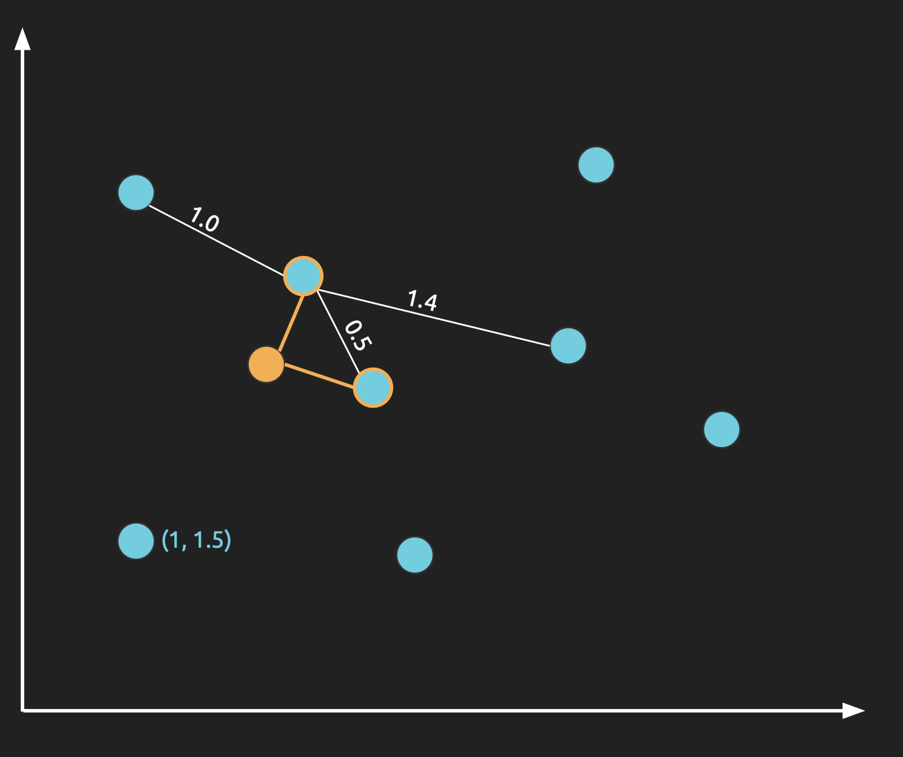

Slide 8
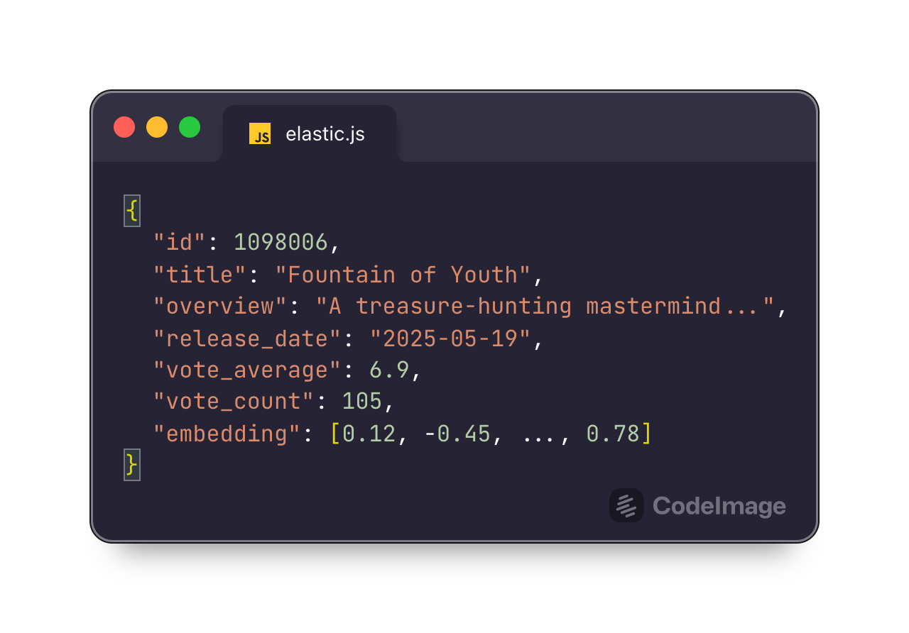
Dataset Overview

Slide 9
Final Thoughts The Future of Search Is Semantic
Embeddings are the future of search
Combining LLMs with vector databases unlocks powerful tools
This project shows how easy it is to build intelligent search today

Slide 10
Questions?

Slide 11

Thank You
More about me
NAVIN BALAJI RK

